Slide 1


The Bright Coffee Shop
Accelerating Growth:
Sales Performance & Strategic Insights
By Belinda N Madzhie

Slide 2


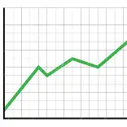
AGENDA
Analyzing Jan 2023 sales volume to maximize our competitive advantage
What you see in this report isn't just a list of transactions—it’s our roadmap for the rest of the year. We’ve analyzed every single deal in this dataset to find out exactly what’s working, so we can double down on our biggest wins

Slide 3

Product Analysis
I will be presenting an overview of our coffee sales performance. The analysis focuses on key areas, including
product performance, sales trends, peak business hours, store performance, and overall KPIs to identify opportunities for growth and operational improvement
Full coffee sales performance story

Slide 4
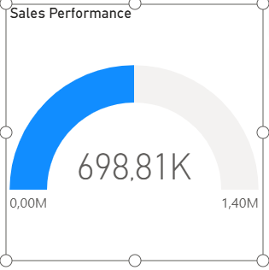
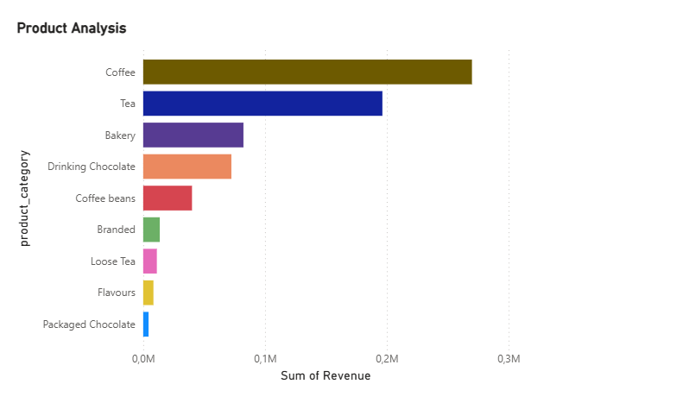
Starting with overall sales performance, we assess total revenue, total quantity sold, and average transaction value over the selected period. This gives us a high-level view of how the business is performing
Product Analysis & Sales performance
In this section, we analyses product performance to identify top-performing and underperforming products based on revenue and quantity sold. This helps us understand customer preferences and demand drivers

Slide 5
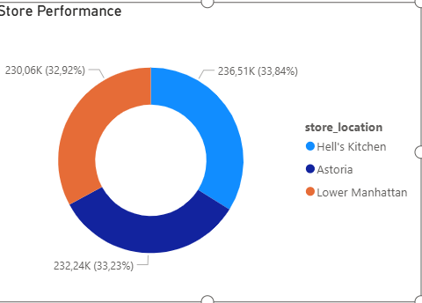
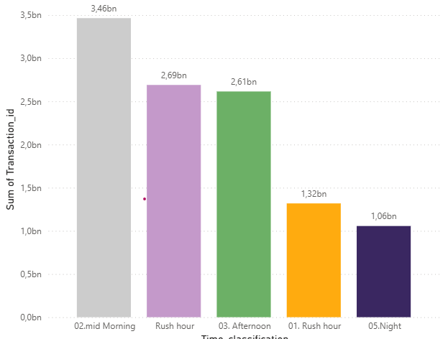
Busy Times (Peak Hours) & Store Performance
Here we analyse sales by time of day to identify peak trading periods. This helps us understand customer traffic patterns and optimise staffing and stock levels during busy hours
To conclude, we review key performance indicators0 including total revenue, total transactions, best-selling products, peak hours, and top-performing stores to provide a complete view of business performance

Slide 6
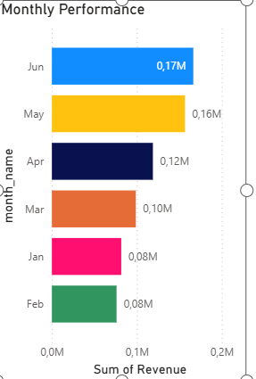
Monthly Performance

Slide 7
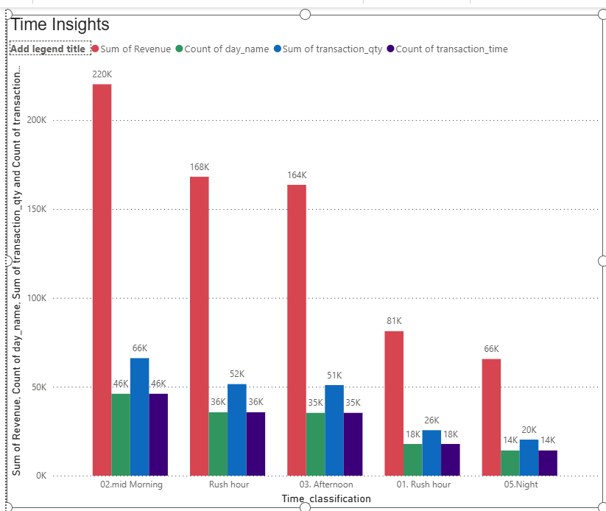
Overall KPI (Top Section
To conclude, we review key performance indicators, including total revenue and total transactions provide a complete view of business performance

Slide 8

Thank You
Belinda
madzhielinda@gmail.com
Visit www.Brightcoffeshop

